Slide 1
Hotel Cancellation Analysis
Group 2: Thomas Dunn, Isaac Gish, Shannon Lloyd, Jason Miller, Tait Ralston
Notes:
Tait:
Good Evening everyone! We are group 2 which includes Thomas Dunn, Isaac Gish, Shannon Lloyd, Jason Miller, and myself. Our final project focused on the analysis of hotel reservation cancellations.

Slide 2
Summary
01
02
03
Purpose
Data Source
Use machine learning (ML) with the other technologies we’ve learned to analyze different attributes of customers’ hotel booking details to create a model that can predict whether or not the booking will be canceled.
The dataset includes data from the INN Hotels Group, which has a chain of hotels in Portugal.
Visuals
Also utilizing the dataset, we created visualizations in Tableau for some trends we noticed while doing our project.
Notes:
Tait:
The purpose of our project was to create a model that would help the hotels predict if reservations are likely to be canceled or kept as booked. To do this, we analyzed our data for contributing factors that seemed to make customers cancel more frequently than others. Our datasource is a dataset from Kaggle and it includes hotel booking reservation data from the INN Hotels group in Portugal. In addition to our Python code containing our data cleansing and model, we imported our dataset into Tableau to create visualizations based off of some trends we identified while working on our project.

Slide 3
Our process
INN Hotel Group Data
A
B
Data Processing
Imported CSV file with PySpark.
Utilizing Python Pandas the data is cleaned, normalized, and standardized prior to modeling.
ML Model Optimization & Evaluation
C
D
Visuals
First we used a TensorFlow model but after 2 Epochs we achieved 100% so we set out to try two other models, Logistic Regression & Random Forest to find the best fit.
We also analyzed our dataset within Tableau to illustrate the populations most likely to cancel their reservations.
Notes:
Tait:
Before building our model and Tableau visualizations we had to import our dataset into a Python notebook to clean and process our data. We imported the CSV file with PySpark and then transformed the table into a Pandas dataframe. Then, we used Pandas to clean, normalize, and standardize the data prior to the machine learning model. Next, we set up a few machine learning models to try and find the best fit for our data which would yield the most ideal result. Finally, we imported the data into Tableau to illustrate a few trends we noticed over the course of our project. I will now pass it off to Jason to discuss our Python notebook code.

Slide 4
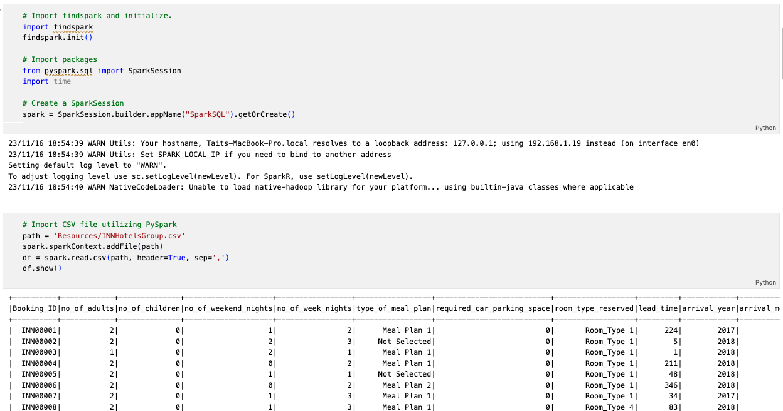
Data Processing - PySpark
Notes:
Jason:
We started by creating a spark session and importing our CSV file into a spark data frame to do some data cleaning. Our data set was pretty good already, but there were several columns that we needed to convert from strings to numeric values.

Slide 5
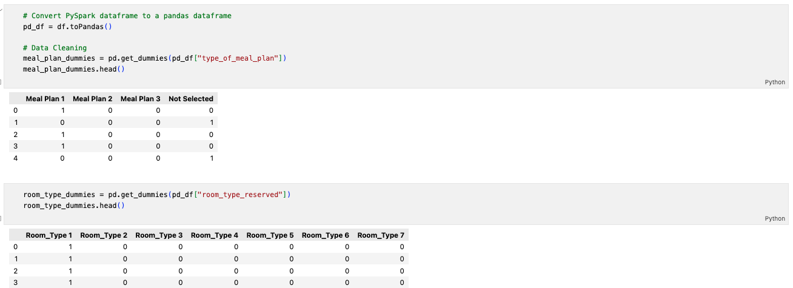
Data Processing - Using dummy variables
Notes:
Jason:
We converted the spark data frame to a pandas data frame. We used get_dummies to convert the meal plans from categorical data to dummy variables, which split it from 1 column into 4. We did the same for the room-type column, which became 7 columns.

Slide 6
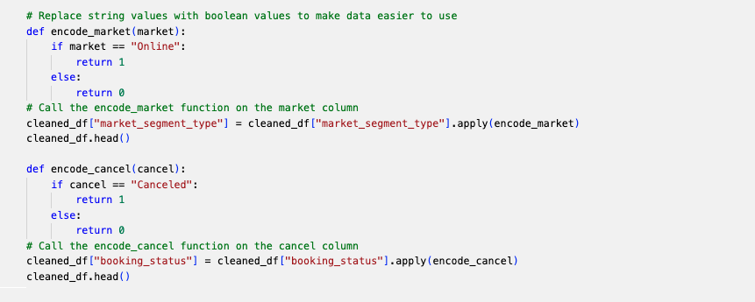
Data Processing - Encoding variables to boolean values
Notes:
Jason:
For the market segment we created a function using an if else statement to change the strings "Offline" and "Online" to boolean values. We then used a similar function to do the same with changing the booking status column for "Not_Canceled" and "Canceled" to boolean values. Then we created the cleaned_df by concatenating the original dataframe with the new columns and dropping the original meal plan and room type columns. We set the Booking_ID column as the index before moving on to creating our model. The booking status was then separated out as our target for our training and testing data for the modeling, which I will pass off to Isaac.

Slide 7
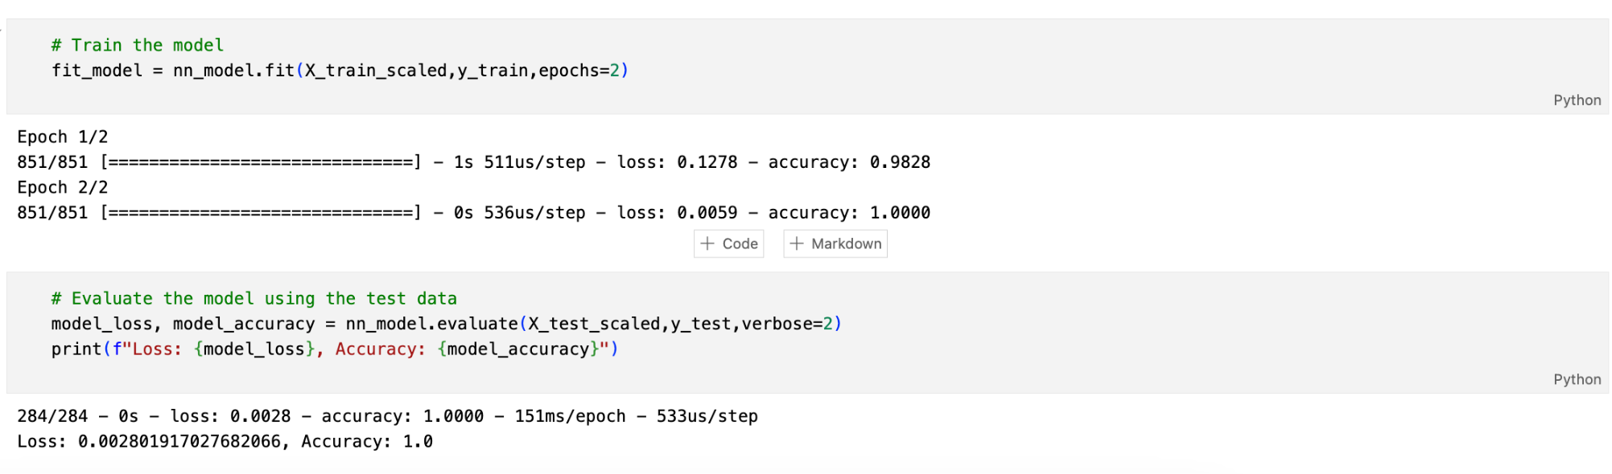
Neural Network TensorFlow Model
Notes:
Isaac:
Our model needed to be able to predict whether or not someone would cancel their hotel booking based on certain features. The model we began with was a neural network using TensorFlow. This was the most previous model that we did in class so it was fresh on each of our minds and we wanted to try it out in the real world. In order to create this model we used the same amount of neurons as half of our features as well as 2 hidden layers. We set the model to be 100 epochs and at first, everything looked great. We were very happy because after just two epochs accuracy was 100%. We were a little suspicious so we did some research and found that our data was overfitting. Basically, our model was going to read back to us exactly what our training data was so we knew we had to try a different model.

Slide 8
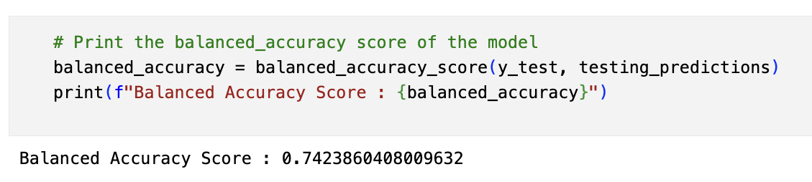
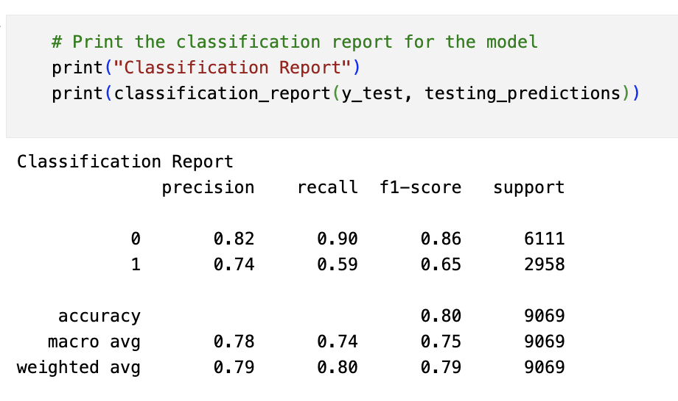
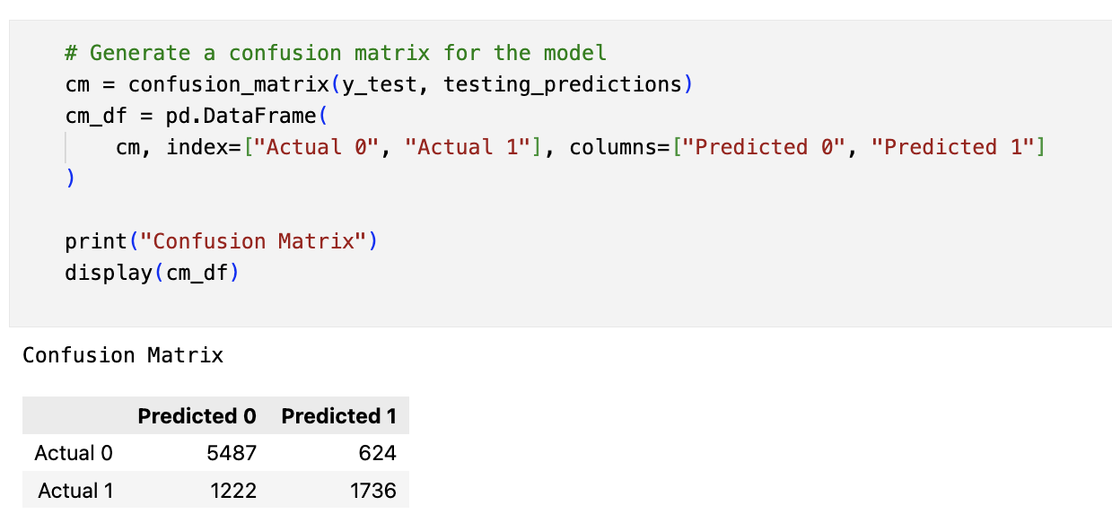
Logistic Regression Model
Notes:
Isaac:
The second model we tried was the logistic regression model because research said that this was the best model for a binary outcome, which ours was either canceled booking or not canceled booking. This model came out with an accuracy of 80%. This model was good and it definitely wasn’t overfitting but we wanted to create a model with higher accuracy so that it could be realistic.

Slide 9
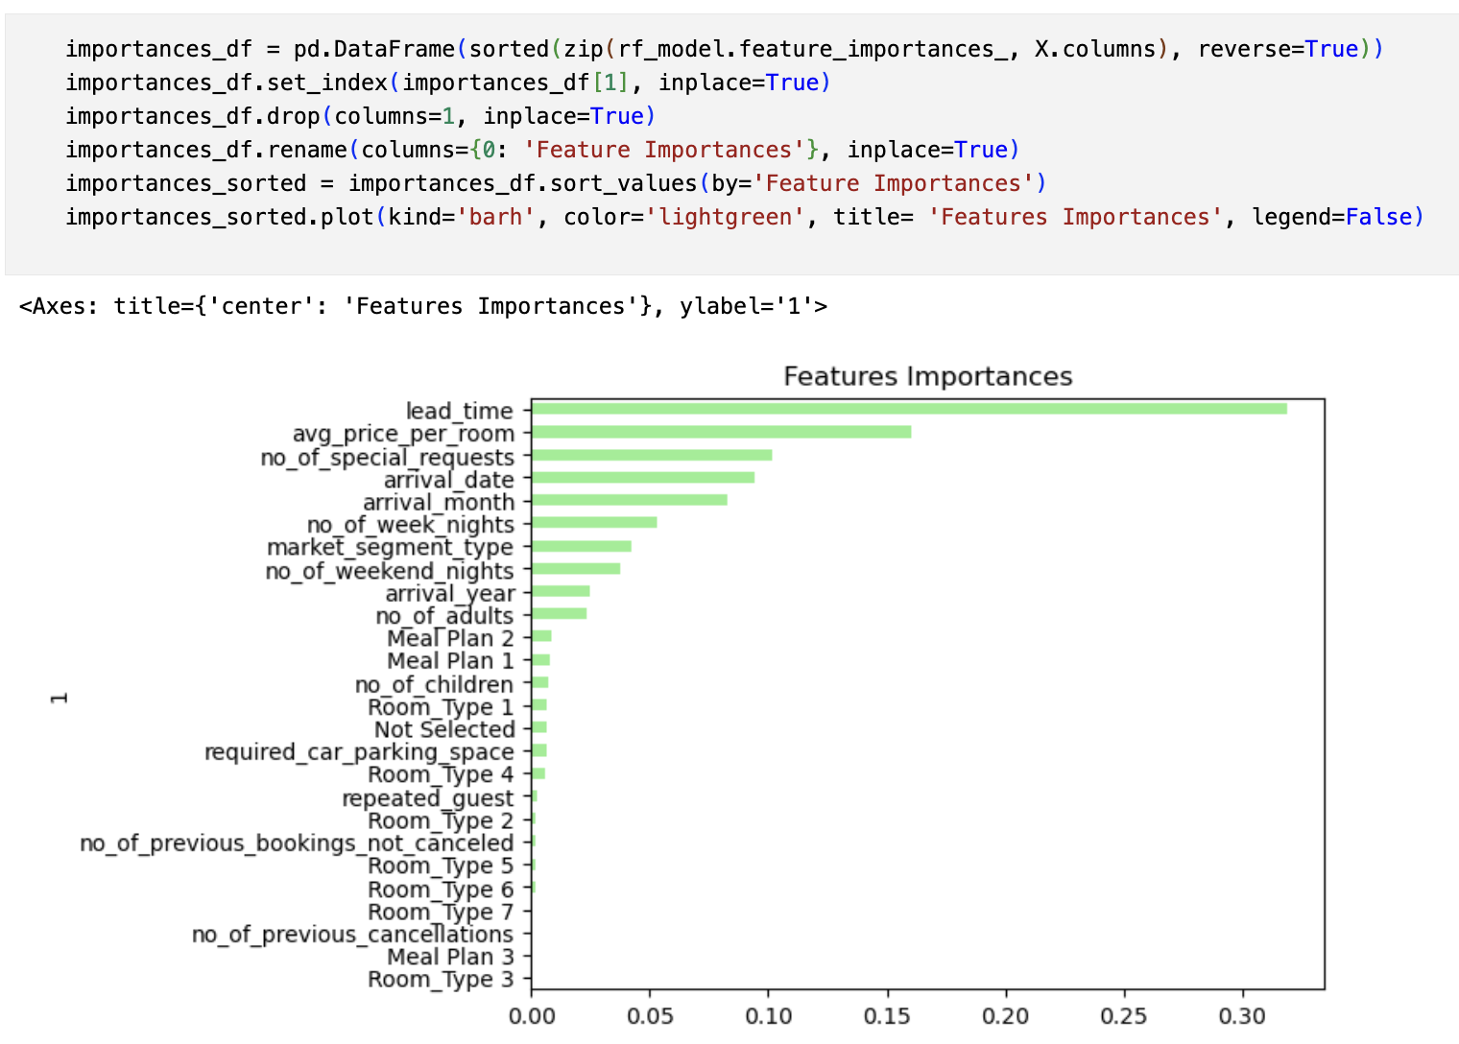
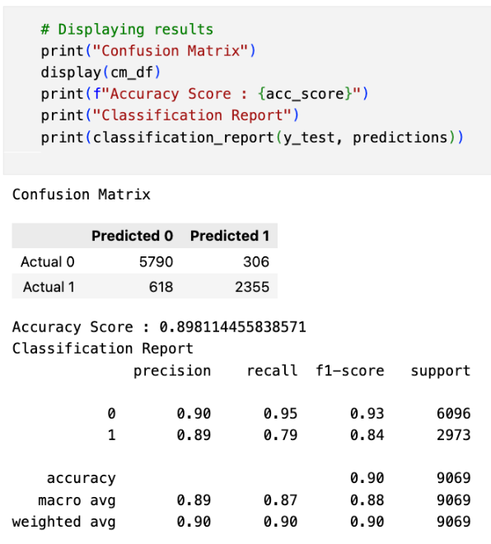
Random Forest Model
Notes:
Isaac:
The last model we tried and ultimately the one we would recommend was the Random Forest model. This model creates multiple decision trees to find the features that affect the outcome the most. Because our model ended with 90% accuracy and a high precision and recall for both cancellations and non-cancellations we decided to stick with this model and move forward with analyzing it. We decided to find the features that mattered the most and do a few supporting visualizations through Tableau. For that, I will pass it off to Thomas and Shannon.
STAY UNTIL THOMAS SAYS

Slide 10
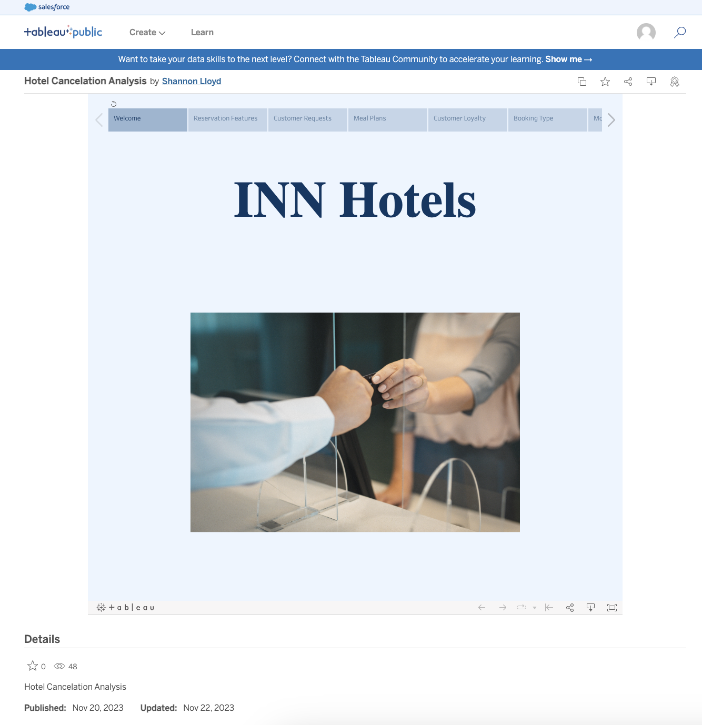
Tableau Analysis
PORTUGAL
EUROPE
Notes:
https://public.tableau.com/app/profile/shannon.lloyd/viz/HotelCancelationAnalysis_17005441395550/Welcome
Thomas & Shannon

Slide 11
Thanks!
Any questions?
Notes:
Tait:
To sum up, by utilizing data cleaning and processing techniques we have learned in class and different machine learning models we were able to find the right one that did not overfit our data too much and still gave us a decent Accuracy Score and Classification Report. This let us to find a few trends which will enable the hotels to predict whether or not customers will cancel their reservations.
Thank you and are there any questions?

